Slide 1

Python Fundamentals
The Art of Clean Logic
Variables, Data Types, Operators & Control Flow

Slide 2
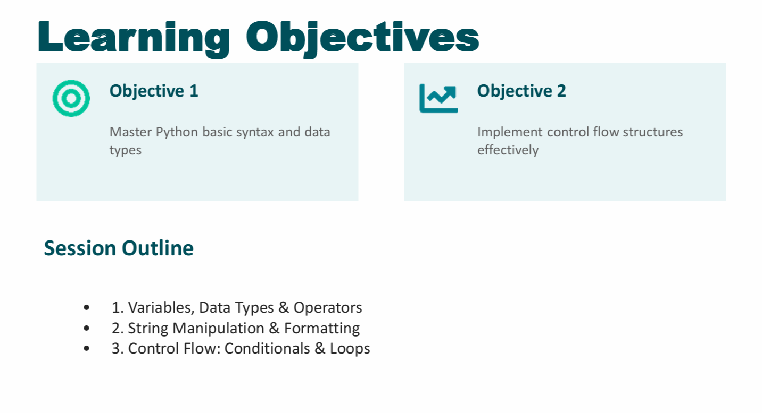
Notes:
Two models with the same accuracy behave very differently in deployment. Why? Distribution shift and variance: Because accuracy is an average, while deployment exposes models to changing data distributions and different levels of variance.

Slide 3
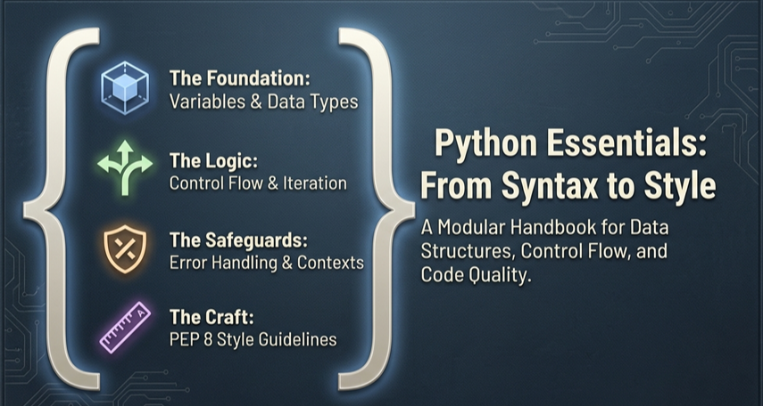
Notes:
Two models with the same accuracy behave very differently in deployment. Why? Distribution shift and variance: Because accuracy is an average, while deployment exposes models to changing data distributions and different levels of variance.

Slide 4
Part 1
Variables, Data Types & Operators
Notes:
Two models with the same accuracy behave very differently in deployment. Why? Distribution shift and variance: Because accuracy is an average, while deployment exposes models to changing data distributions and different levels of variance.

Slide 5
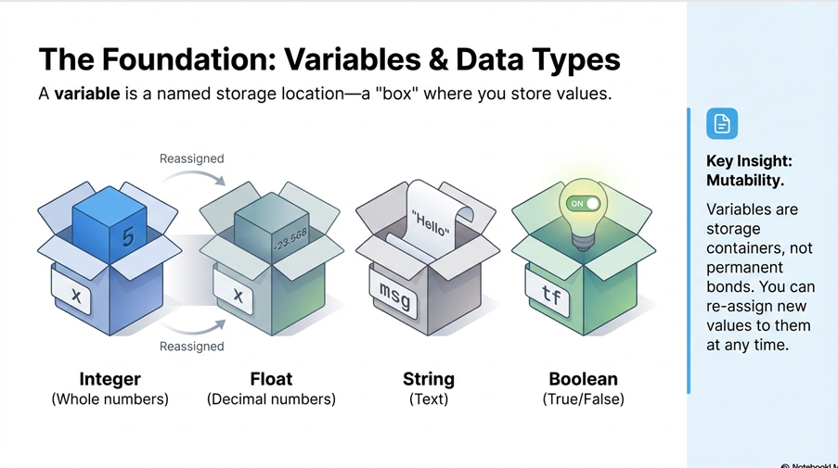
Notes:
Two models with the same accuracy behave very differently in deployment. Why? Distribution shift and variance: Because accuracy is an average, while deployment exposes models to changing data distributions and different levels of variance.

Slide 6
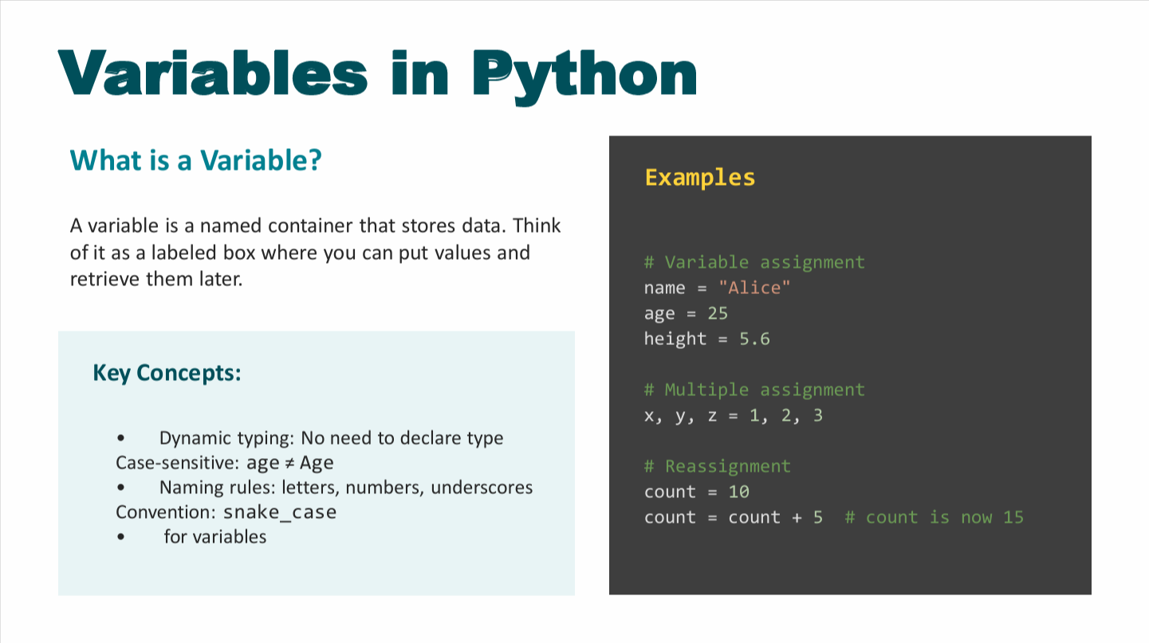
Notes:
Two models with the same accuracy behave very differently in deployment. Why? Distribution shift and variance: Because accuracy is an average, while deployment exposes models to changing data distributions and different levels of variance.

Slide 7
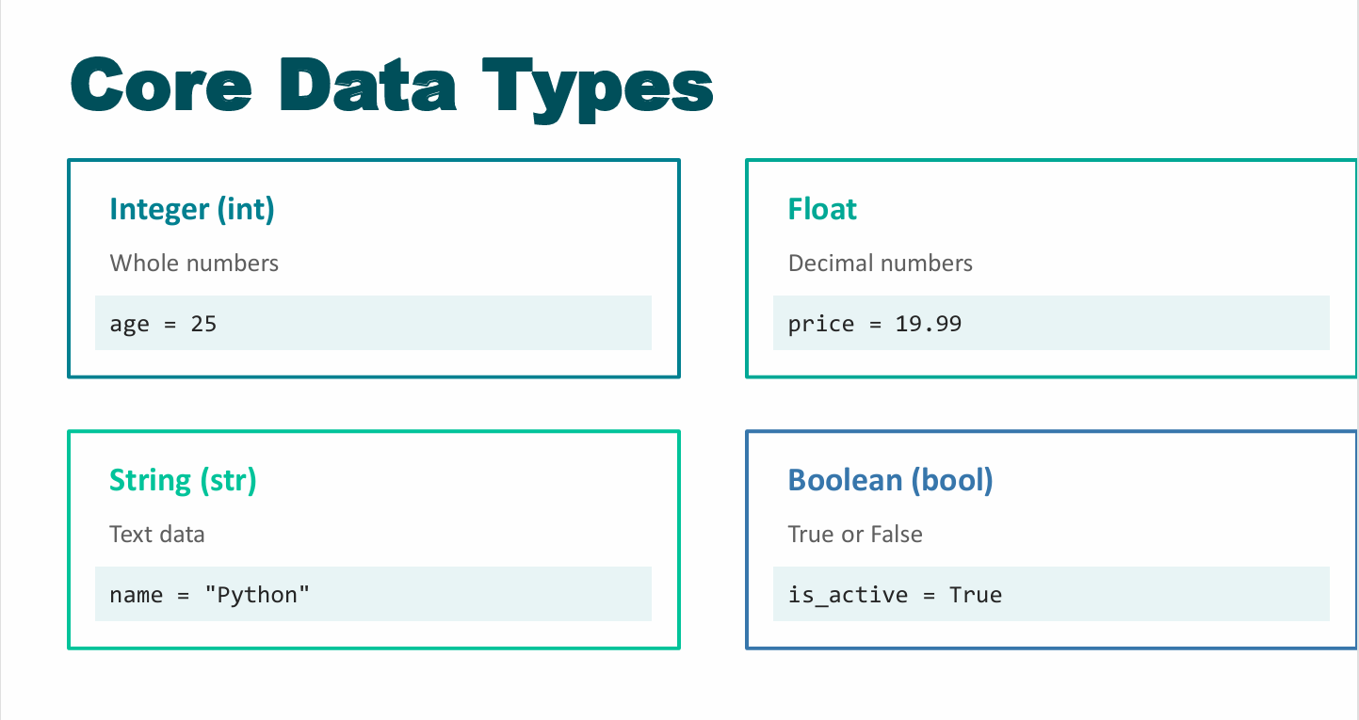
Notes:
Two models with the same accuracy behave very differently in deployment. Why? Distribution shift and variance: Because accuracy is an average, while deployment exposes models to changing data distributions and different levels of variance.

Slide 8
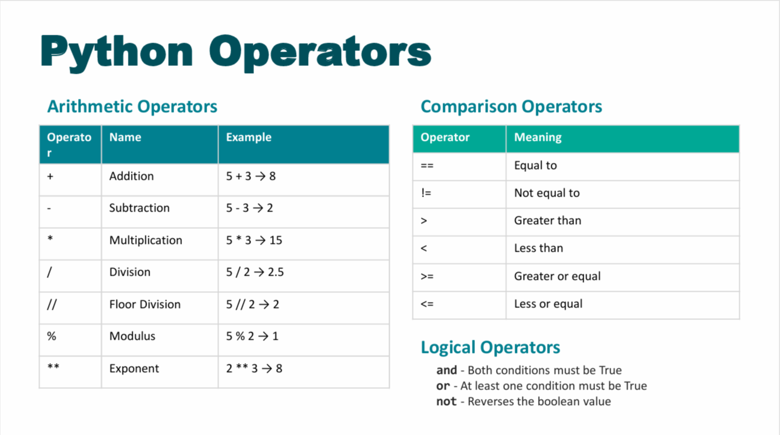
Notes:
Two models with the same accuracy behave very differently in deployment. Why? Distribution shift and variance: Because accuracy is an average, while deployment exposes models to changing data distributions and different levels of variance.

Slide 9
Part 2
String Manipulation & Formatting
Notes:
Two models with the same accuracy behave very differently in deployment. Why? Distribution shift and variance: Because accuracy is an average, while deployment exposes models to changing data distributions and different levels of variance.

Slide 10
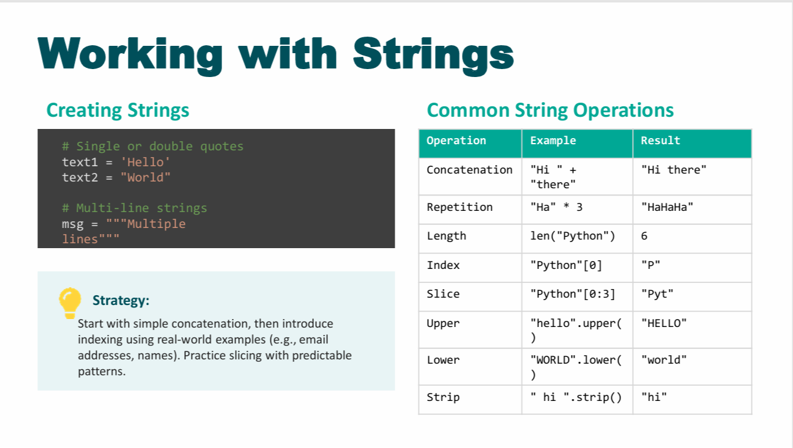
Notes:
Two models with the same accuracy behave very differently in deployment. Why? Distribution shift and variance: Because accuracy is an average, while deployment exposes models to changing data distributions and different levels of variance.

Slide 11
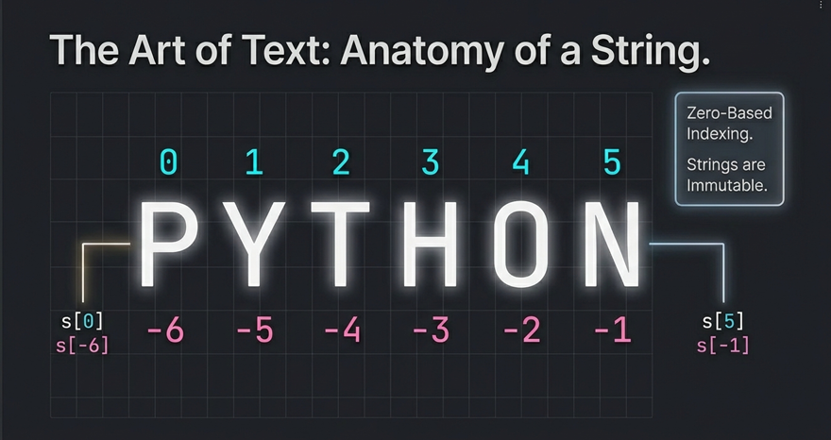
Notes:
Two models with the same accuracy behave very differently in deployment. Why? Distribution shift and variance: Because accuracy is an average, while deployment exposes models to changing data distributions and different levels of variance.

Slide 12
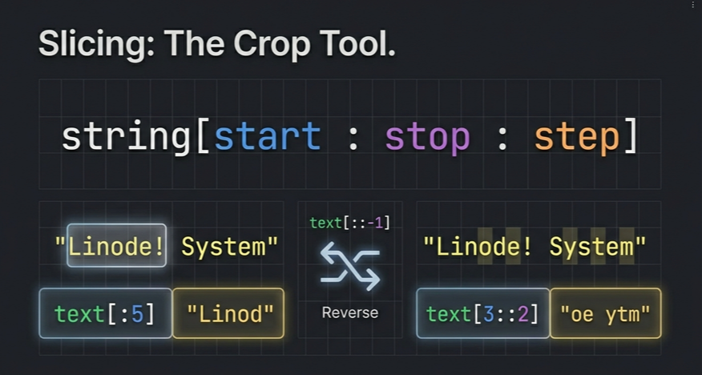
Notes:
Two models with the same accuracy behave very differently in deployment. Why? Distribution shift and variance: Because accuracy is an average, while deployment exposes models to changing data distributions and different levels of variance.

Slide 13
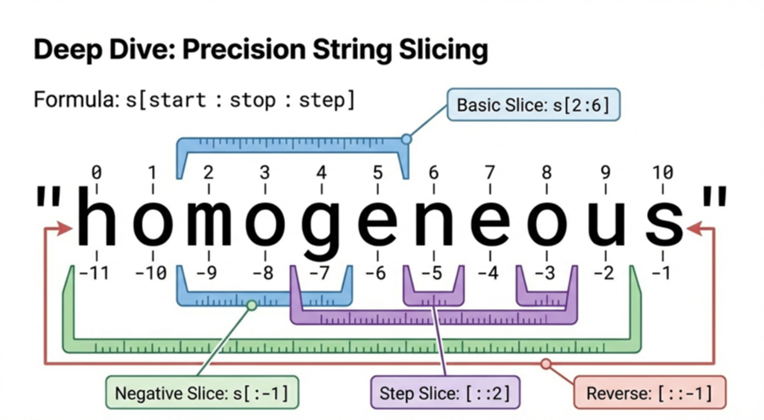

Slide 14
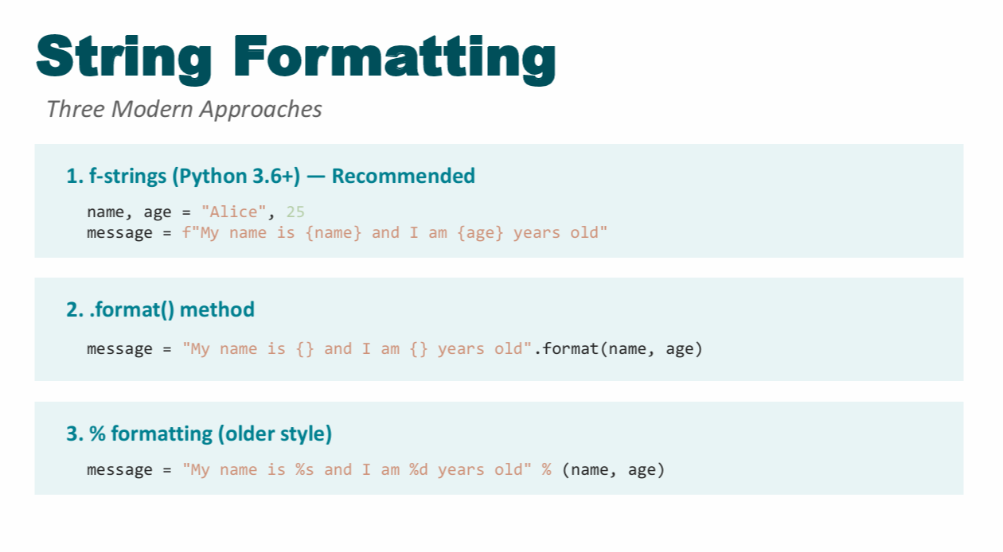

Slide 15
Part 3
Control Flow Structures

Slide 16
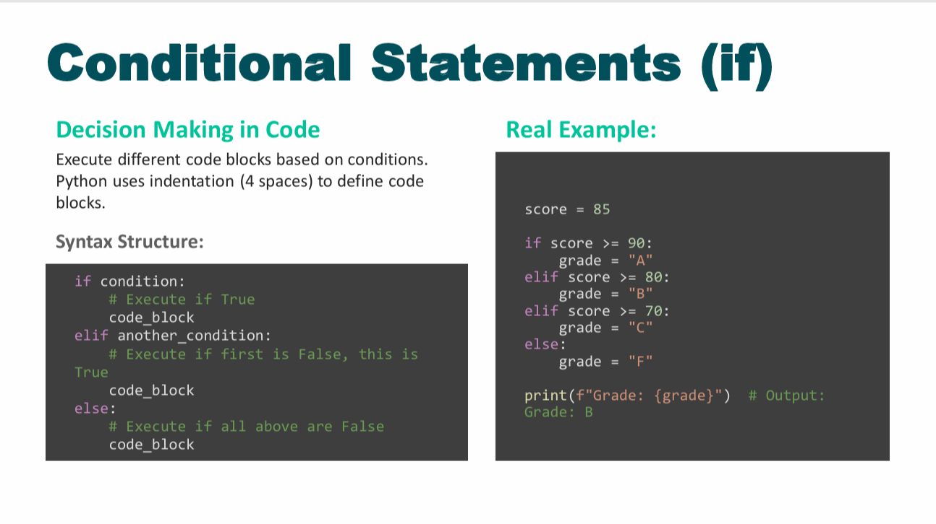

Slide 17
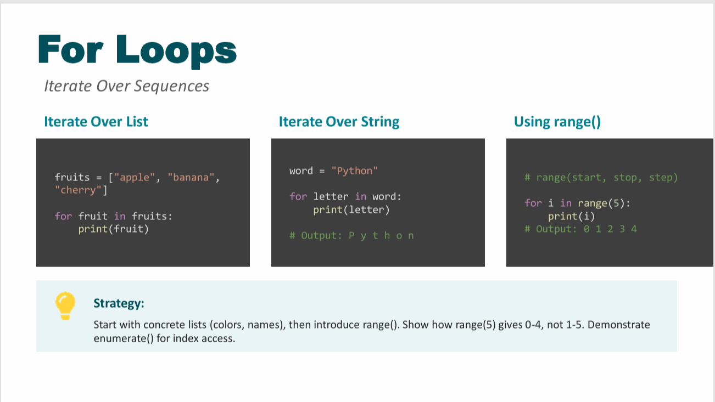

Slide 18
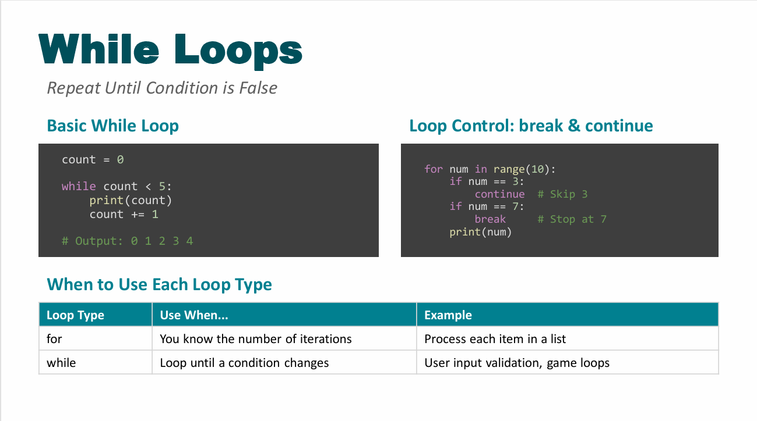

Slide 19
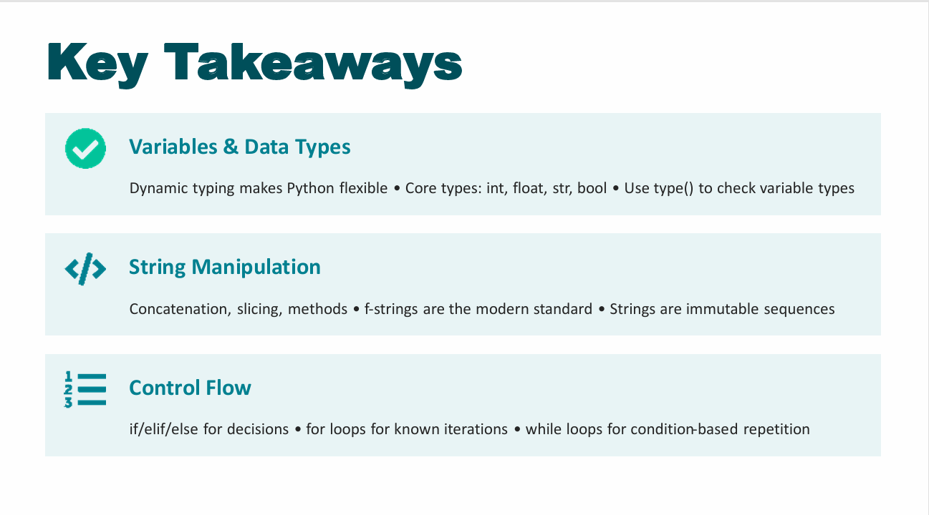

Slide 20
Practice Makes Perfect
Keep coding, keep learning!

